Slide 1
FAS 424
Animal Models in Biomed. Res.
Mammalian Animals Used in Biomedical Research

Slide 2
Types of Animals
Rat - This rodent species is one of the most widely used organisms in medical research. In fact, it is believed to be the first domesticated laboratory mammal. The species that gave rise to all types of laboratory rat strains is Rattus norvegicus (brown rat). Over time, selective breeding produced the first strain of standardized rats known as the King Albino (later designated the PA strain).

Slide 3
Types of Animals
Other strains or “lines” include the Sprague Dawley, Fischer 344, Holtzman albino strains, Long-Evans, and Lister black hooded rats.
  Advantages
    Rats adapt well to new surroundings.
    Rats are easy to handle.

Slide 4
Types of Animals
    Rats have short pregnancy periods (21 to 23 days).
    Rats produce more offspring (10 to 12 pups per litter).
    Many symptoms of human conditions can be replicated in rats.

Slide 5
Types of Animals
  Research Areas
    Areas of investigation for which rats are used include pharmacology, toxicology, nutrition, behavior, and numerous other topics. Of particular importance is the investigation of cancer process and the exploration of therapeutic agents.

Slide 6
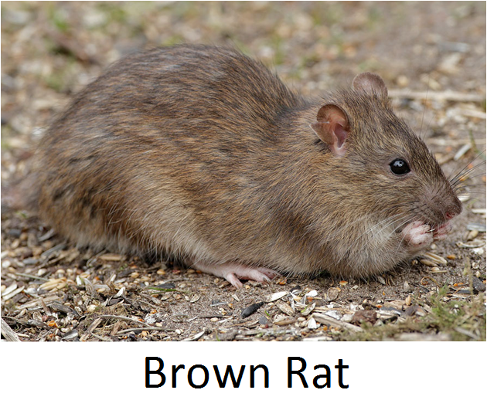
Types of Animals

Slide 7
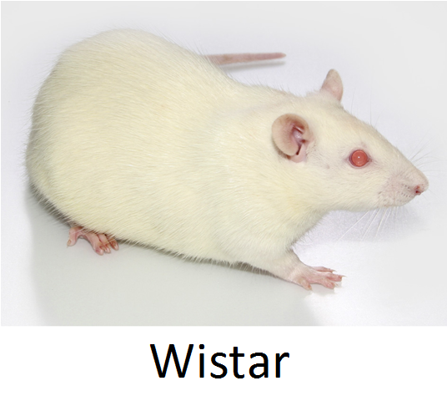
Types of Animals

Slide 8
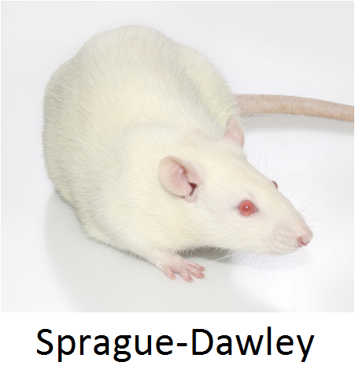
Types of Animals

Slide 9
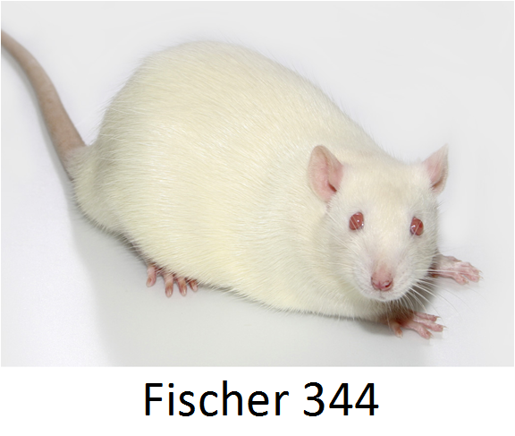
Types of Animals

Slide 10
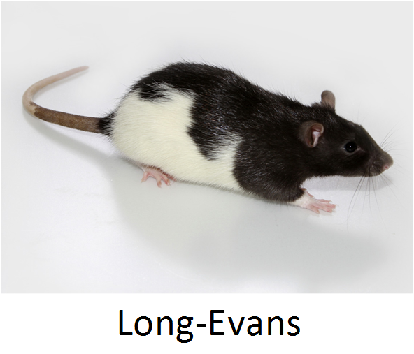
Types of Animals

Slide 11
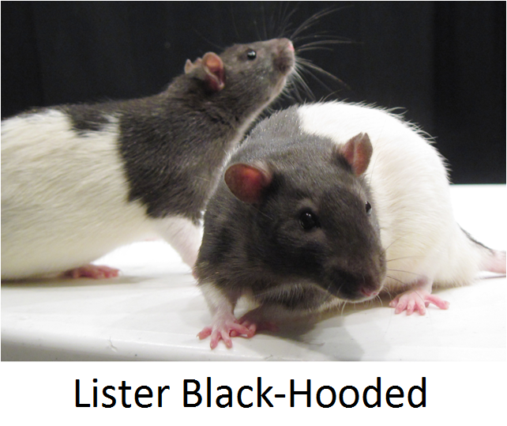
Types of Animals

Slide 12
Types of Animals
Mouse - This rodent species is the most commonly used mammalian research model. Laboratory mice are the same species as the house mouse (Mus musculus), but are often different in behavior and physiology. There are hundreds of established inbred, outbred, and transgenic strains. Two of the most commonly used strains of mice are the C57BL/6 and BALB/c.

Slide 13
Types of Animals
  Advantages
    Mice are easy to maintain and handle.
    Mice breed early (about 50 days of age).
    Mice have short gestation periods (about 20 days).
    Mice produce more offspring (10 to 12 pups per litter).
    Mice are closely associated with humans.

Slide 14
Types of Animals
  Research Areas
    Mice are used for research in genetics, psychology, medicine and other scientific disciplines.

Slide 15
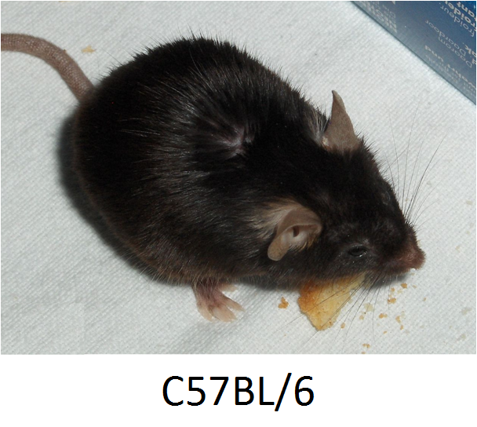
Types of Animals

Slide 16
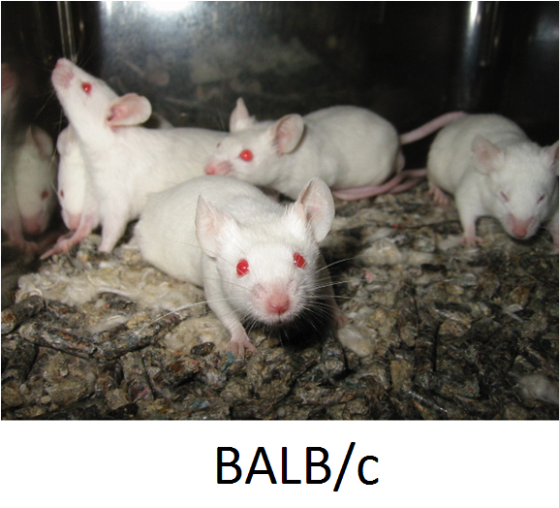
Types of Animals

Slide 17
Types of Animals
Rabbit - Although the total number of rabbits used for research in the US has declined, this animal species continues to be an essential animal model. The New Zealand White and Dutch Belted strains of rabbits are commonly used for research activities.

Slide 18
Types of Animals
  Advantages
    Rabbits are very docile and non-aggressive.
    Rabbits are easy to handle and observe.
    Rabbits are widely bred and very economical compared with the expense of larger animals.

Slide 19
Types of Animals
    Rabbits reach sexual maturity age at about 4 to 7 months, depending on breed size.
    Rabbits have short gestation periods (about 31 days).

Slide 20
Types of Animals
  Research Areas
    Biomedical conditions for which major advances have been made using rabbits include atherosclerosis, ophthalmic diseases, infectious diseases, and orthopedic research. In addition, rabbits continue to be used in research of human male reproductive system.

Slide 21
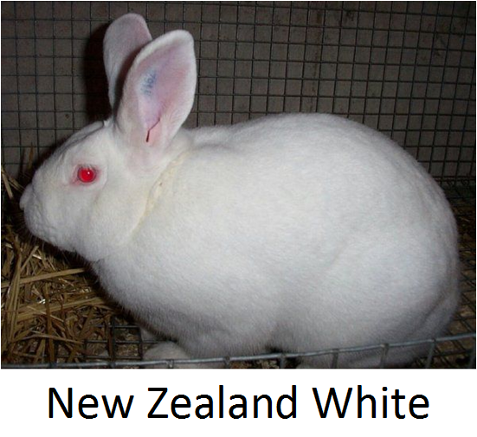
Types of Animals

Slide 22
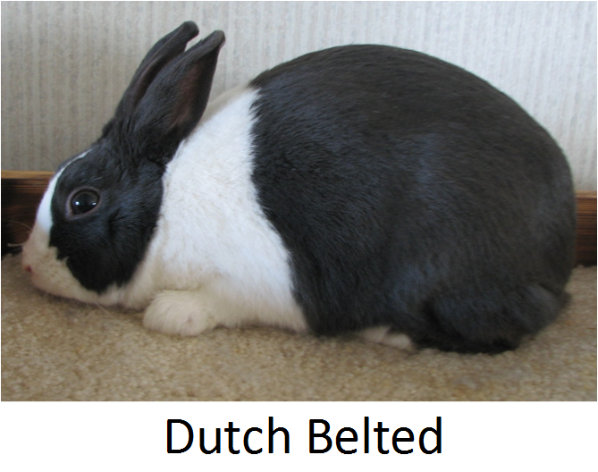
Types of Animals

Slide 23
Types of Animals
Guinea Pig - Although this rodent species (Cavia porcellus) is one of the most commonly used laboratory animals, the numbers used per year in biomedical research has steadily declined. Amongst various strains, the Hartley albino stock is the most commonly used today.

Slide 24
Types of Animals
  Advantages
    Guinea pigs are small, clean and docile.
    Guinea pigs are easy to maintain and handle.
    Guinea pigs reach sexual maturity age at about 3 to 5 weeks.

Slide 25
Types of Animals
    Guinea pigs breed year-round, with gestation periods averaging 63 to 68 days.
    The average size of a guinea pig litter is 1 to 4 pups, but can be as many as 7 or more.

Slide 26
Types of Animals
  Research Areas
    Guinea pigs play an important role in hearing research, toxicology, and the study of allergic diseases, non-infectious pulmonary diseases, reproductive disorders, osteoarthritis, and atherosclerosis. They are also used routinely to study a wide variety of bacterial, viral, and fungal infections.

Slide 27
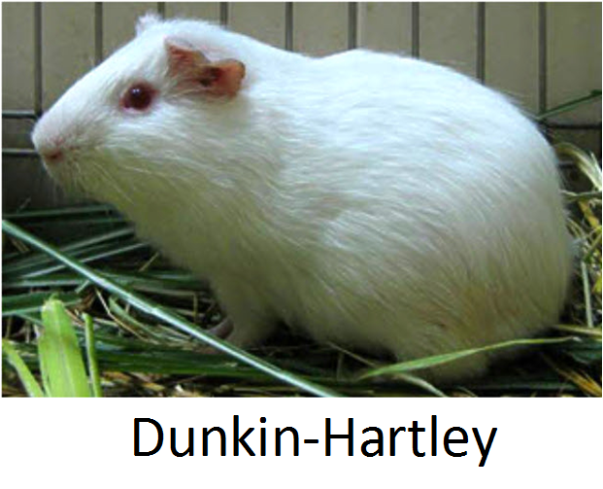
Types of Animals

Slide 28
Types of Animals
Swine - Domestic pigs (Sus scrofa) are known as suitable animal models for human disease based upon their comparative anatomy and physiology. The main porcine systems studied in biomedical research are cardiovascular, dermal, immunological, digestive, and urological.

Slide 29
Types of Animals
Standard farm pig breeds used in biomedical research protocols include the Landrace, Yorkshire, and Duroc. However, their use is typically limited to short-term studies because of their rapid growth rate, high feed intake, and large adult weight (500 to 800 pounds).

Slide 30
Types of Animals
Miniature breeds have proven to be valuable research animals due to their relatively slow growth rate and decreased adult weight (155 to 265 pounds). Some miniature breeds that are currently available include the Yucatan, Hanford, Sinclair, and Göttingen.

Slide 31
Types of Animals
  Advantages
    Pigs can be safely handled due to their friendly temperament.
    There is a greater acceptance by the general public for the use of pigs as laboratory species.

Slide 32
Types of Animals
    Both farm and miniature breeds reach sexual maturity between 4 and 6 month of age.
  Research Areas
    Emerging models are being developed for the investigation of stroke, diabetes, toxicology, and endotoxic shock.

Slide 33
Types of Animals
    Swine are also considered to be one of the main models for training in surgery, organ transplantation, and endoscopic and laparoscopic techniques, as well as being a preclinical model for the testing of pharmaceuticals and biomechanical devices.

Slide 34
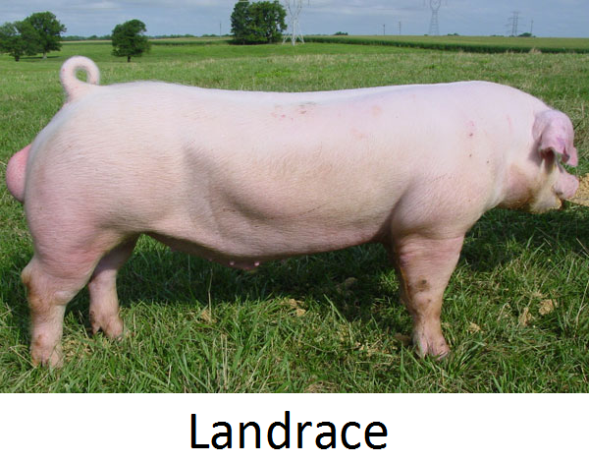
Types of Animals

Slide 35
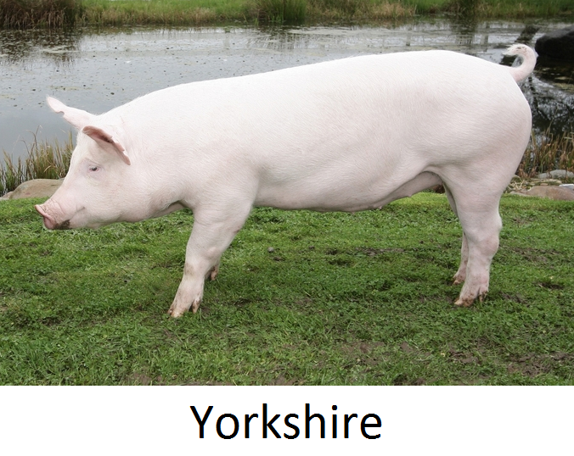
Types of Animals

Slide 36
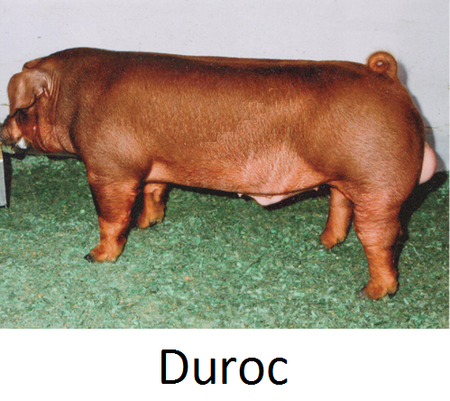
Types of Animals

Slide 37
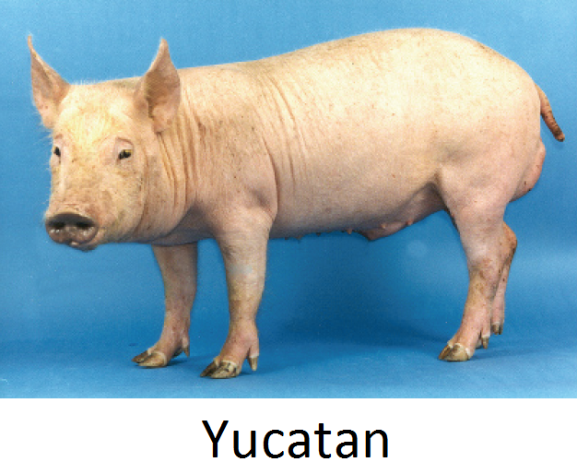
Types of Animals

Slide 38
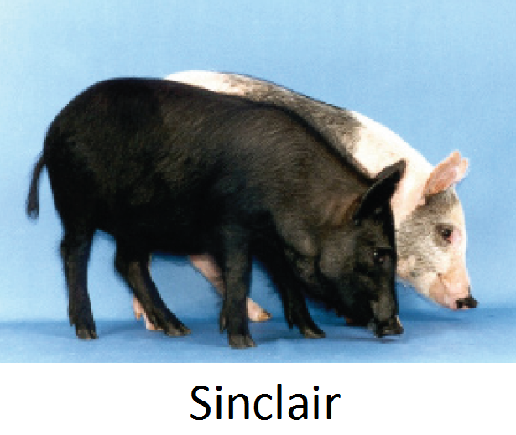
Types of Animals

Slide 39
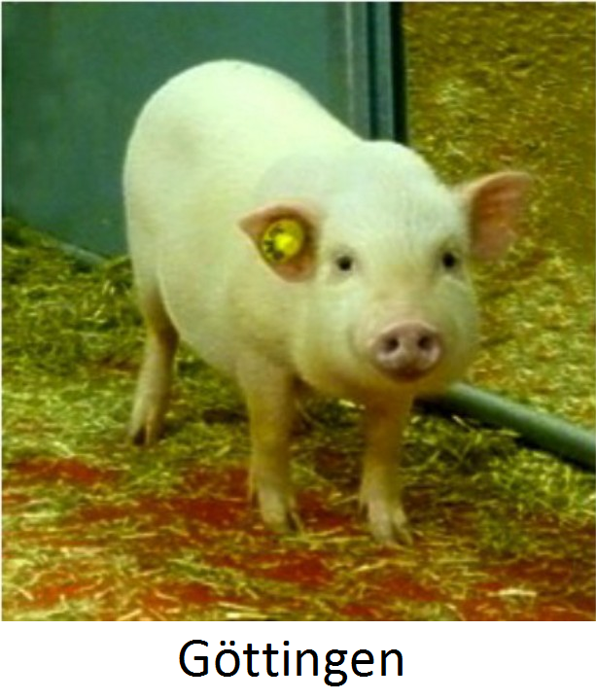
Types of Animals

Slide 40
Types of Animals
Sheep - Although sheep (Ovis aries) are less common than smaller species in laboratory settings, they are an optimal study animal. Sheep are considered the animal of choice for pregnancy-related research, and are also used to study multiple sclerosis, medical device implants, burn injury, and smoke inhalation.

Slide 41
Types of Animals
  Advantages
    Sheep adapt rapidly and extremely well to a laboratory situation.
    Sheep have a placid nature and relate positively to handlers.
    Their body weight and size approximates to that of a human.

Slide 42
Types of Animals
  Research Areas
    Sheep have been used as experimental subjects in such diverse fields of study as reproductive physiology, cardiovascular physiology, immunology, fluid and electrolyte homeostasis, neurophysiology and neuroanatomy, thermoregulation, hematology, digestive behavior, nutrition and gastrointestinal physiology.

Slide 43
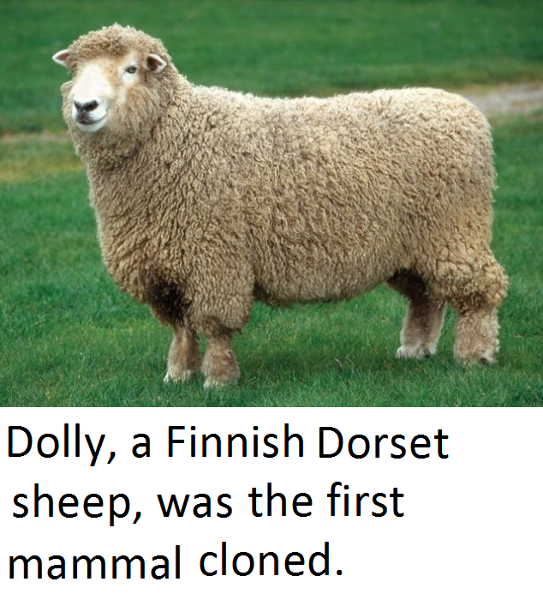
Types of Animals

Slide 44
Types of Animals
Dog - Transgenic mice and swine have replaced the domestic dog (Canis familiaris) for many research models. Dogs purchased for research are classified by the US Department of Agriculture (USDA) as random-source or purpose-bred.

Slide 45
Types of Animals
Purpose-bred dogs are bred and raised for biomedical research, while random-source dogs are obtained from a variety of sources, but are not bred specifically for research. The dog predominately used in research is the purpose-bred beagle.

Slide 46
Types of Animals
  Advantages of Beagles
    They have a placid temperament.
    They are relatively small in size.
    They are easy to breed and keep in groups.
    They can easily be housed in kennels.

Slide 47
Types of Animals
  Research Areas
    The dog has been used as a model for many human conditions in areas such as cardiovascular study, diabetes mellitus, ulcerative colitis, open heart surgery, organ transplantation, pharmacology and toxicology.

Slide 48
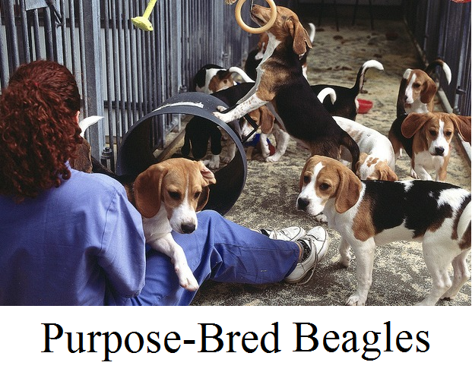
Types of Animals

Slide 49
Types of Animals
Cat - Of the many animal species used in biomedical research, the cat (Felis catus) has some physiological features more in common with humans. Therefore, it has been used extensively in behavioral and neurological studies. Most cats used in biomedical research are purpose-bred, obtained from USDA licensed breeders.

Slide 50
Types of Animals
  Advantages of Purpose-Bred Cats
    They have known genetic histories as far back as 20 generations.
    They have accurate and complete vaccination records.
    They are accustomed to living in laboratory conditions.

Slide 51
Types of Animals
  Research Areas
    Cats have been used as research subjects for the investigation of neurological, cardiovascular, and respiratory diseases, and the immune system. Scientists have also used cats in cancer research, genetic disorders, and eye, ear, and infectious disease research.

Slide 52
Types of Animals
Ferret - Since ferrets share many anatomical and physiological features with humans, they have been promoted as animal models in biomedical research. The North American black-footed ferret (Mustela nigripes) is currently listed as an endangered species; therefore, it is never encountered in the laboratory.

Slide 53
Types of Animals
However, the domestic or European ferret (Mustela putorius furo) has been used in the laboratory for the study of human influenza, severe acute respiratory syndrome (SARS), cystic fibrosis, and peptic ulcer disease, among others.

Slide 54
Types of Animals
  Advantages
    Ferrets are easily trained animals that adapt well to laboratory conditions.
    Both male (hob) and female (jill) ferrets reach sexual maturity at the age of 6 to 12 months.
    The gestation period lasts 39 to 42 days.

Slide 55
Types of Animals
    Domestic ferrets give birth to an average of eight kits (1 to 18 kits).
    Because female ferrets are seasonal breeders (March to September), induced ovulators, and will remain in heat for 3 to 6 months if not mated, sexually unaltered female ferrets are not frequently used in research.

Slide 56
Types of Animals
  Research Areas
    Ferrets are used in many broad areas of study, including cardiovascular disease, nutrition, respiratory disease, airway physiology, gastrointestinal disease, pharmacology, and toxicology.

Slide 57
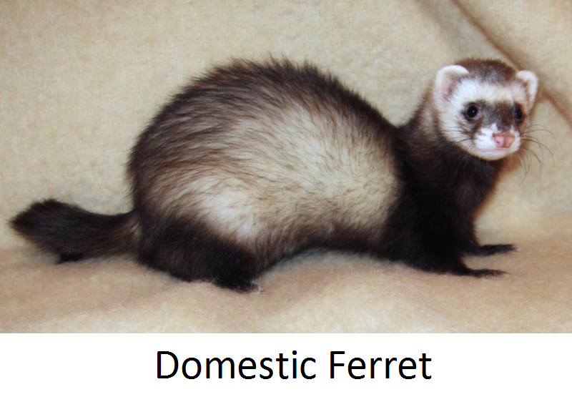
Types of Animals

Slide 58
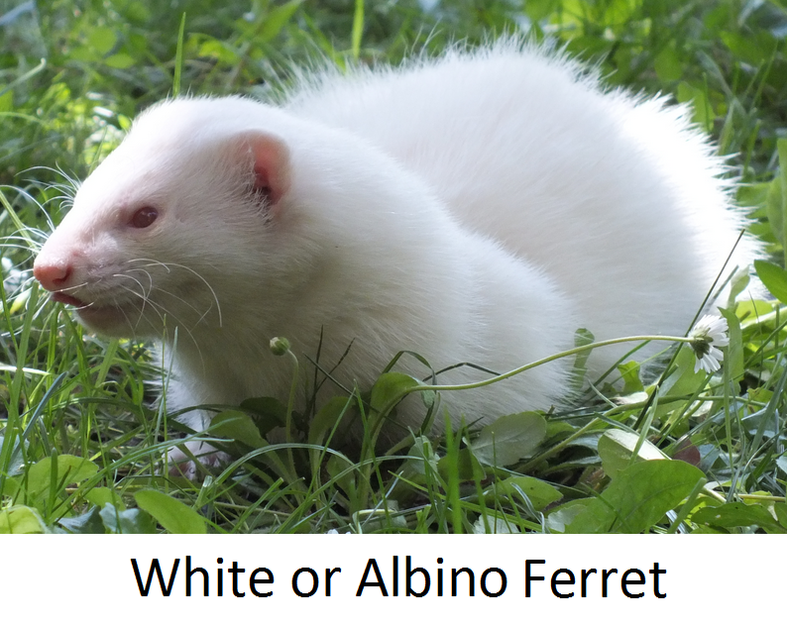
Types of Animals

Slide 59
Types of Animals
Rhesus Macaque - Although this primate has been used extensively in biomedical research, the rhesus macaque (Macaca mulatta) is listed as “Least Concern” in the International Union for Conservation of Nature (IUCN) Red List of Threatened Species.

Slide 60
Types of Animals
Native to northern India, Bangladesh, Nepal, Pakistan, Myanmar, Thailand, Afghanistan, Vietnam, and southern China, troops of rhesus monkeys inhabit a great variety of habitats from grasslands to arid and forested areas, but also close to human settlements.

Slide 61
Types of Animals
However, it is desirable to have national primate centers where captive breeding can ensure that animals are of known pedigrees instead of the often unreliable wild-caught animals.

Slide 62
Types of Animals
  National Primate Research Centers
    California National Primate Research Center (affiliated with the University of California, Davis).
    New England National Primate Research Center (affiliated with Harvard University).

Slide 63
Types of Animals
    Oregon National Primate Research Center (affiliated with Oregon Health Sciences University).
    Southwest National Primate Research Center (affiliated with the Texas Biomedical Research Institute).
    Tulane National Primate Research Center (affiliated with Tulane University).

Slide 64
Types of Animals
    Washington National Primate Research Center (affiliated with the University of Washington).
    Wisconsin National Primate Research Center (affiliated with the University of Wisconsin).
    Yerkes National Primate Research Center (affiliated with Emory University).

Slide 65
Types of Animals
  Advantages
    They are anatomically, physiologically and genetically similar to humans (about 93% genetic similarity).
    They are widely available and relatively easy to keep in captivity.

Slide 66
Types of Animals
    Although females reach sexual maturity when they are three years old, they reproduce until about 20 years of age, with gestation periods of 164 days.

Slide 67
Types of Animals
  Research Areas
    The rhesus macaque has facilitated medical breakthroughs such as the development of the rabies, smallpox, and polio vaccines.
    The rhesus macaque has facilitated the creation of drugs to manage HIV/AIDS.

Slide 68
Types of Animals
    The rhesus macaque has facilitated the understanding of the female reproductive cycle and development of the embryo.
  Note: Rhesus macaques, like many other macaques, are natural hosts of the Herpes B virus. The virus does not typically harm the monkeys, but is very dangerous to humans in the rare event that it jumps species.

Slide 69
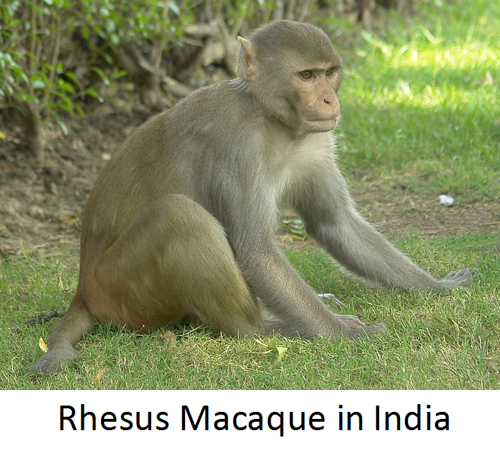
Types of Animals

Slide 70
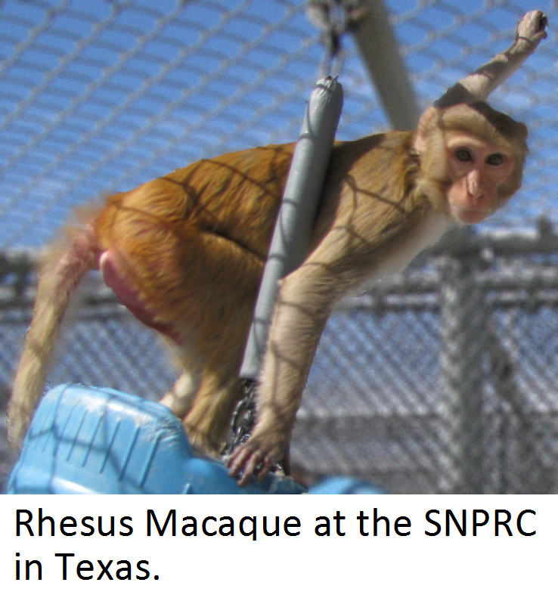
Types of Animals

Slide 71
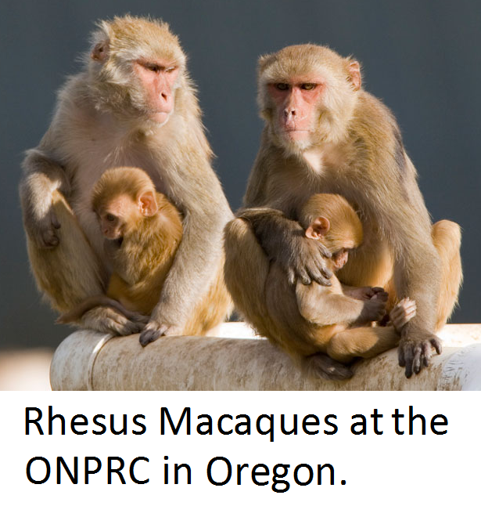
Types of Animals

Slide 72
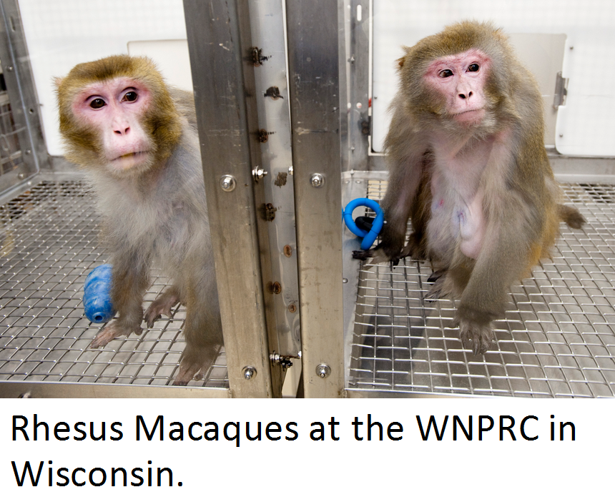
Types of Animals

Slide 73
Types of Animals
Cynomolgus Macaque - This primate has been used extensively in biomedical experiments. Yet, the International Union for Conservation of Nature (IUCN) Red List categorizes the cynomolgus macaque (Macaca fascicularis) as “Least Concern”.

Slide 74
Types of Animals
Native to Cambodia, Laos, Myanmar, Thailand, Vietnam, West Malaysia, and the islands of Sumatra, Java, and Borneo, the cynomolgus macaque, also known as the crab-eating macaque and long-tailed macaque, inhabits a great variety of habitats, including lowland rainforests and riverside and coastal forests.

Slide 75
Types of Animals
However, in countries where it is not a native species, the cynomolgus monkey is considered to be a nuisance to indigenous fauna and flora and agriculture. The cynomolgus monkey is an introduced alien species in countries such as Taiwan, Papua New Guinea, Fiji, Samoa, and the Solomon Islands.

Slide 76
Types of Animals
  Advantages
    They are physiologically similar to humans.
    They are widely available and highly adaptable to captive conditions.
    Females reproduce until about 24 years of age, with gestation periods ranging from 162 to 193 days.

Slide 77
Types of Animals
  Research Areas
    Cynomolgus macaques have been widely used by researchers in breast cancer, uterine cancer, diabetes, cardiovascular disease, drug development and testing, neuroscience, pharmacology, toxicology, reproductive physiology, and psychiatry.

Slide 78
Types of Animals
  Note: Cynomolgus macaques are known carriers of Herpes simian B virus, the endemic virus of macaque monkeys.

Slide 79
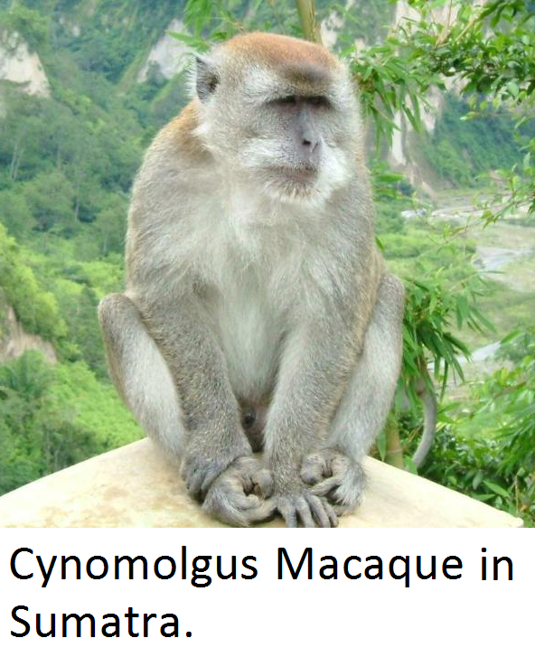
Types of Animals

Slide 80
Types of Animals
Chimpanzee - For many years, chimpanzees (Pan troglodytes) have been used to advance scientific knowledge and the public’s health. However, a series of events have changed the chimpanzee’s status.

Slide 81
Types of Animals
  In 2010, the European Union adopted Directive 2010/63 which bans the use of great apes (gorillas, orangutans, bonobos, and chimpanzees) in biomedical research.
  In 2011, the National Academy of Sciences’ Institute of Medicine (IOM) determined that chimpanzees are unnecessary for most biomedical research.

Slide 82
Types of Animals
  In 2013, the National Institutes of Health (NIH) recommended to cut funding for most federally supported experiments on chimps and designate NIH-owned chimpanzees for retirement and transfer to the Federal Sanctuary System.

Slide 83
Types of Animals
  In 2015, the U.S. Fish and Wildlife Service completed a final rule (80 FR 34499) to list all chimpanzees, both wild and captive, as endangered under the Endangered Species Act of 1973.
  It is estimated that the remaining non-government owned chimpanzees will be retired to sanctuaries by 2020.

Slide 84
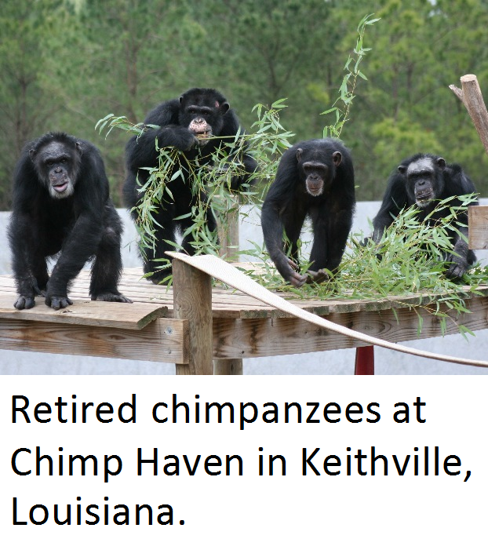
Types of Animals

Slide 85
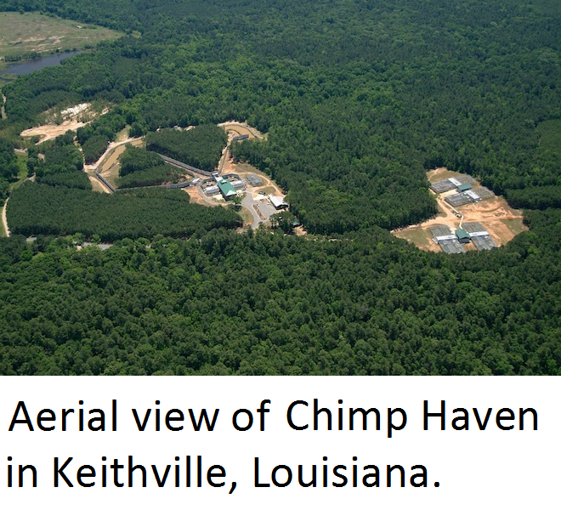
Types of Animals

